Slide 1

Joins II

Slide 2
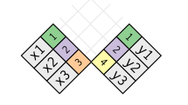
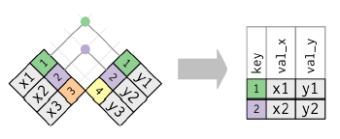
Graphical Depiction
Inner Join
Notes on Inner Join
Generally Inappropriate
Easy to Lose Observations

Slide 3
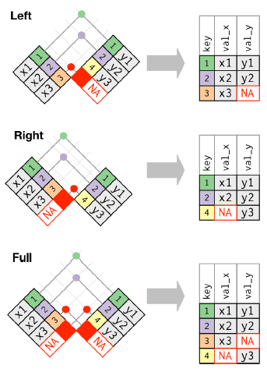
Graphical Depiction
Outer Join

Slide 4
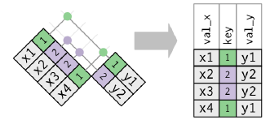
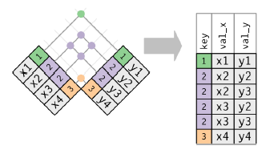
Graphical Depiction
Duplicate Keys
Using Left Join
One Table Has Duplicates
Both Tables Have Duplicates

Slide 5
Closing
Disperse and Make Reasonable Decisions

